Slide 1


LENDING CLUB CASE STUDY
Team:
Renganathan Rajagopal
Anshu Dhiman

Slide 2

About Lending Club
The company is the largest online loan marketplace, facilitating personal loans, business loans, and financing of medical procedures.
Problem Statement
Borrowers who default cause the largest amount of loss to the lenders. In this case, the customers labelled as 'charged-off' are the 'defaulters'
Objective
The company wants to understand the driving factors behind loan default, i.e. the variables which are strong indicators of default.

Slide 3
Approach for Analysis
Data Understanding
Data Cleaning
Univariate
Analysis
Bivariate
Analysis
Recommendations
Gone through the data and the data dictionary to know about each variable and getting some domain knowledge
Removing the null valued columns,rows, unnecessary variables
Using Counts plots for different features recording the observation
Analysing the two variable simultaneously and how they are impacting loan status.
This portion include Important take aways and suggestions for the business stakeholders to reduce the loss

Slide 4
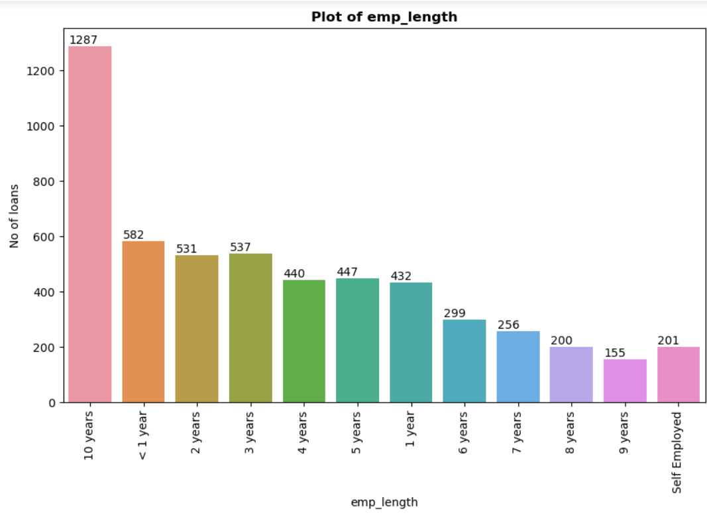
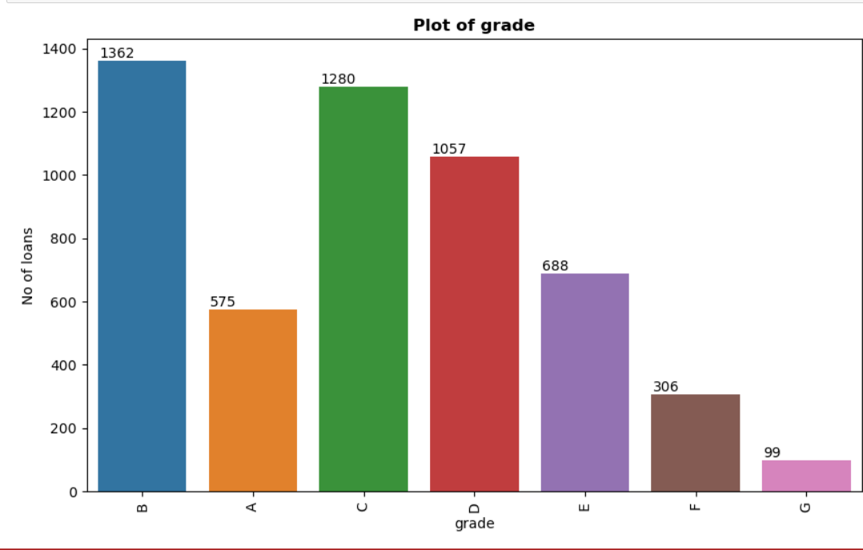
Analysis & Observations (Univariate)
NOTE : The following plots are created taking the data for Loan_status = Charged_off
Count Plot of emp_length shows ,employees with 10 years experience have more defaulted on loan compared with the ones with lesser experience
Count Plot of Grade shows Grade B ,C, D are given more likely to charged off as compared to other grades

Slide 5
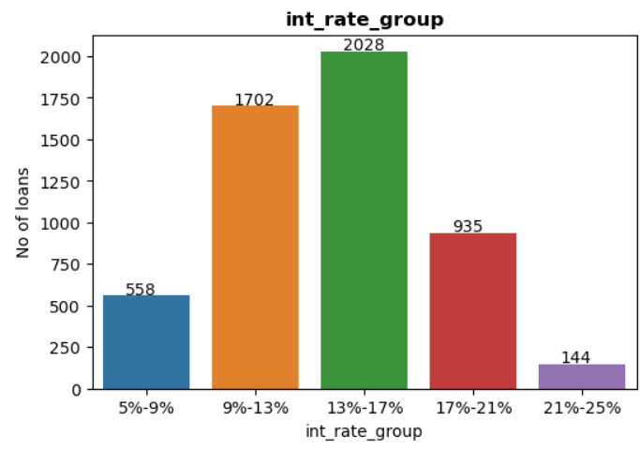
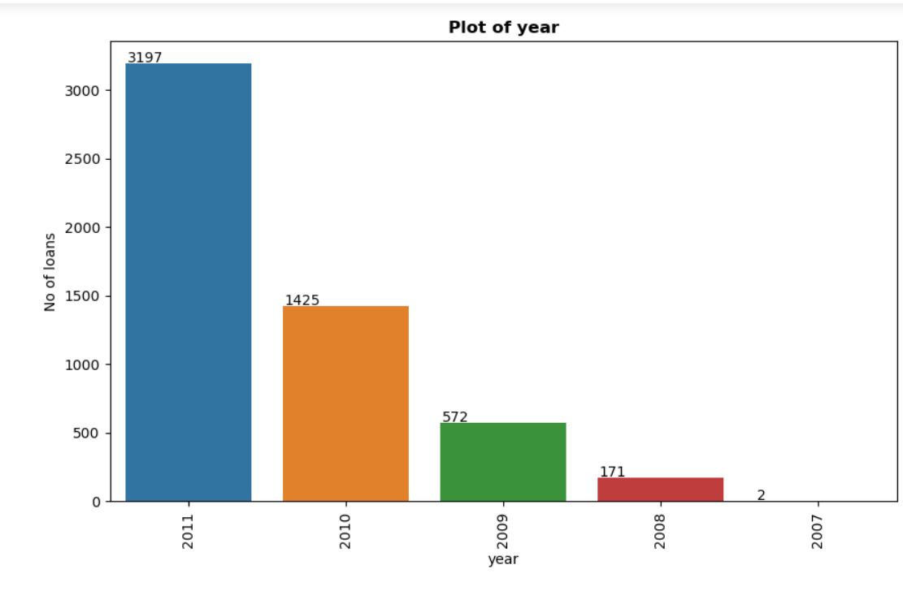
Analysis & Observations (Univariate)
NOTE : The following plots are created taking the data for Loan_status = Charged_off
Interest rate range 13% - 17% is the range with maximum loan defaults
If we notice the % of defaults in each groups we can state that the interest range 21%-25% has maximum chances of defaults (as high as 44%)
P.S. (Percent here means no. of charged off divided by the total no. of loan issues in a particular interest rate group)
Count Plot of issue year shows the no. of defaulted loans have increased in the year 2011. The trend is increasing with the increase in the year.

Slide 6
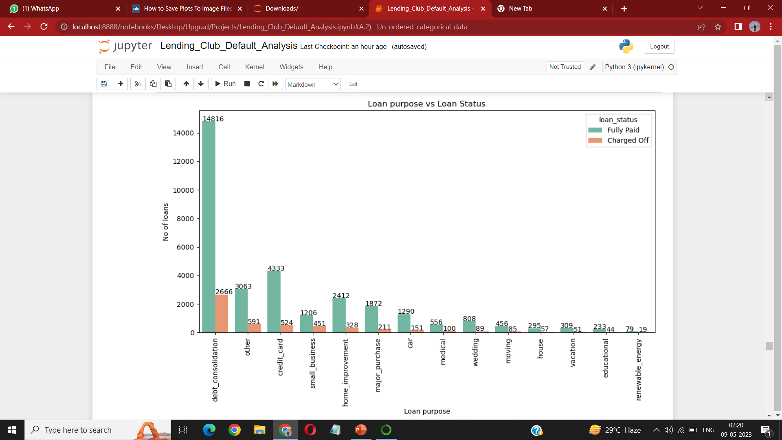
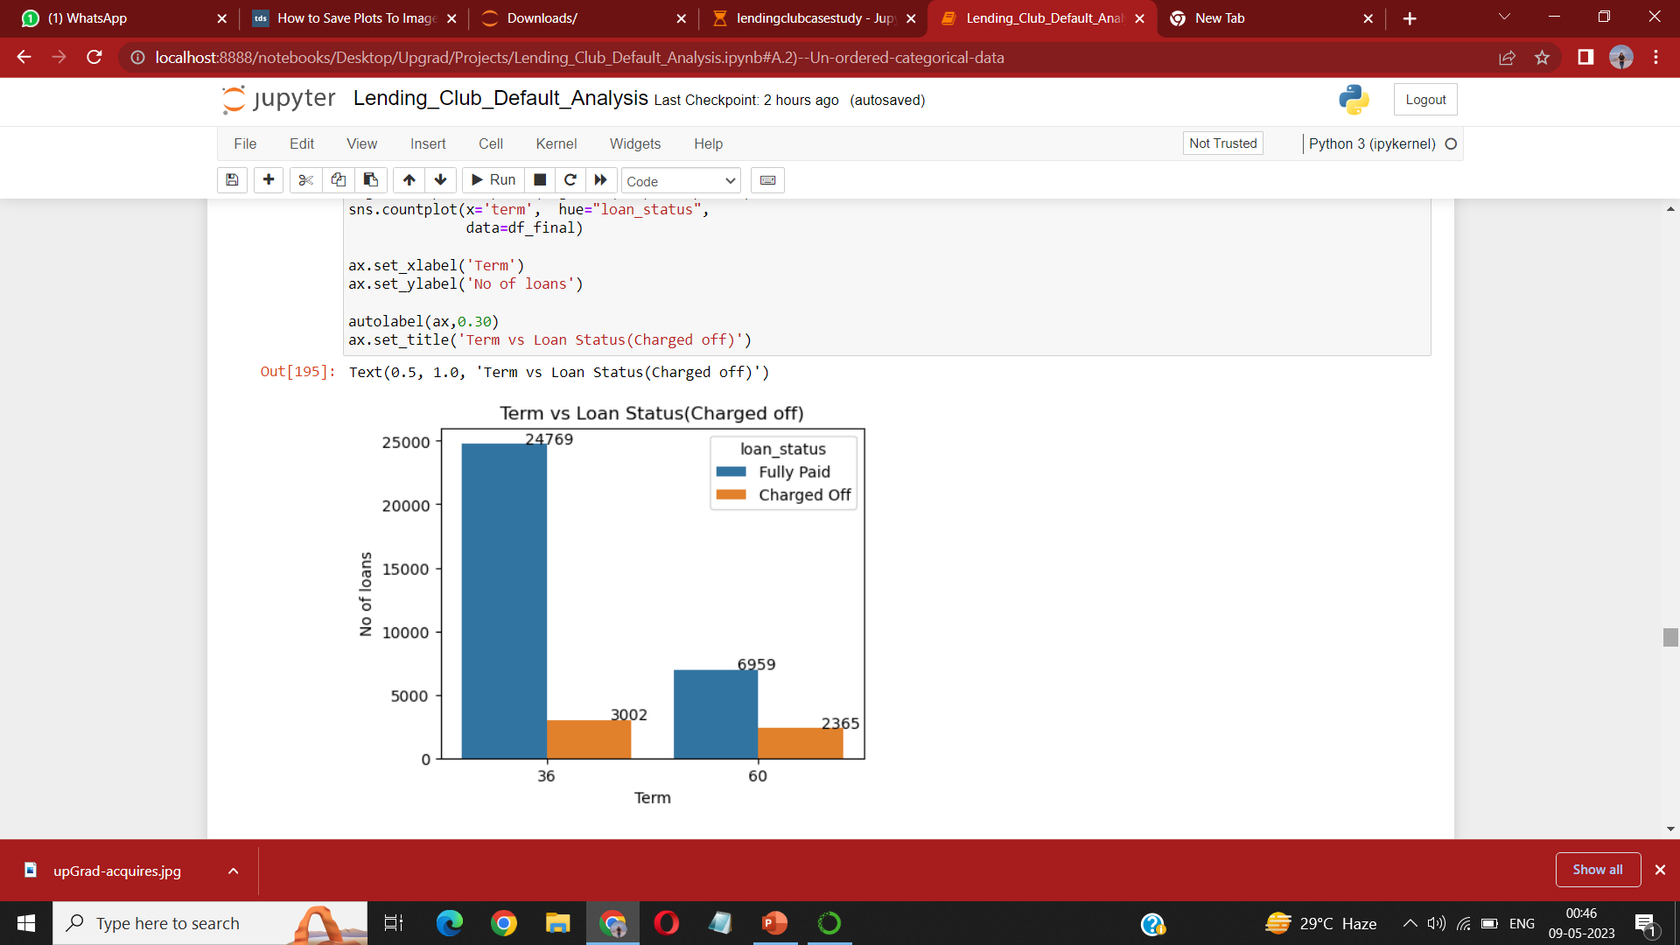
Analysis & Observations (Bivariate)
Loans with purpose debt consolidation, other, credit crd and home improvement categories have failed to pay the loan compared with education / renewable energy
Small business have highest % of charged off
Calculated % charged off in 60 months it is 25% of the total loans issued with a 60 months which is much higher as compared to 36 month tenure so it is more likely for a 60 months loan issued to be a default

Slide 7
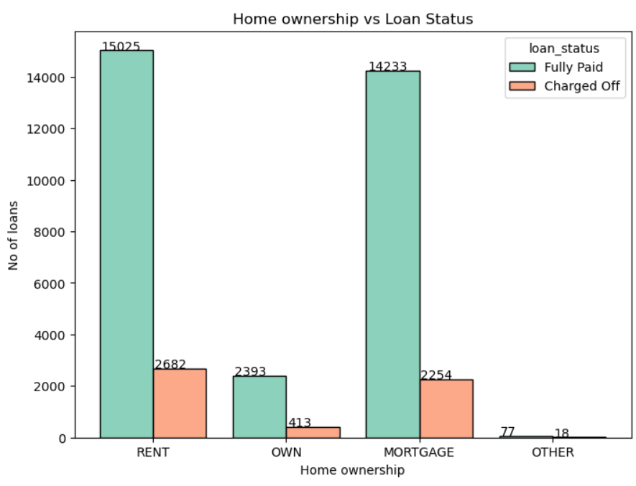
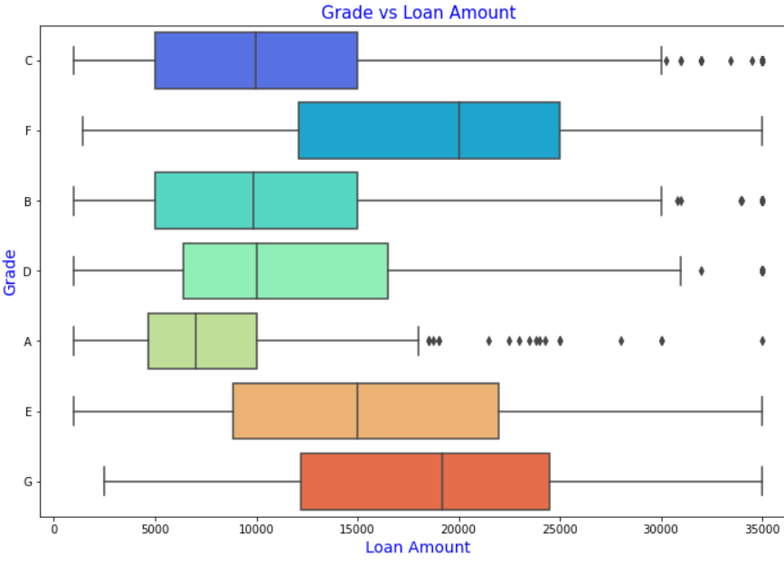
Analysis & Observations (Bivariate)
NOTE : The box plot is created taking the data for Loan_status = Charged_off
People who are in Rent or Mortage have failed to pay the loan compared with people in Own house
Grade F, G and E are the three category which has higher charged off
The median of F and G is around 20k and Q3 at 25k
Grade A has a median at 7.5k and is at the least

Slide 8
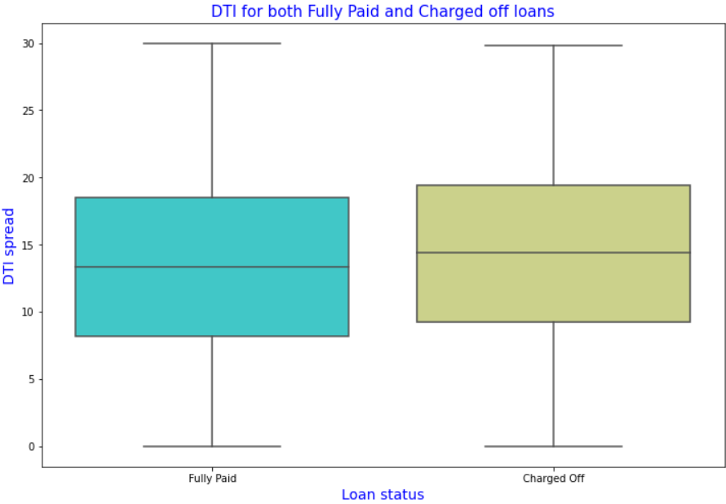
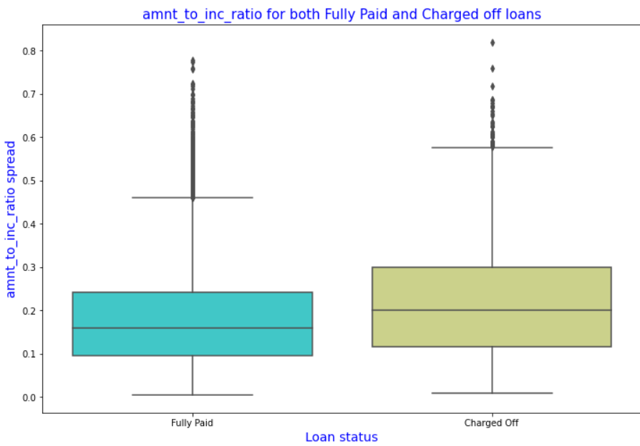
Analysis & Observations (Bivariate)
DTI is not a significant factor because the median is close to each other for Fully Paid and Charged Off
Amnt_to_int_ratio is an indicator of bad loans as for charged off the median and Q3 is higher

Slide 9
Recommendations:
Lending club should reduce the high interest loans for 60 months tenure, they are prone to loan default.
Small business loans are defaulted more. Lending club should cautiously give the loans to them.
Borrowers with mortgage home ownership are taking higher loans and defaulting the approved loans. High Alert for Lending club when loan amount asked is 12000 or more.
Charging an Interest rate ranging between 21-25% can lead to a list of defaulters so we can minimize giving loans to the profile on which interest rate is calculated high.
Grades can be one of the indicator for detecting defaulters. When grade is F or G and loan amount is between 15k-20k Those are more likely to be defaulters
Lending Club should keep a check to the number of loan issues to borrowers who are from CA, FL and NY to avoid risks.

